Slide 1
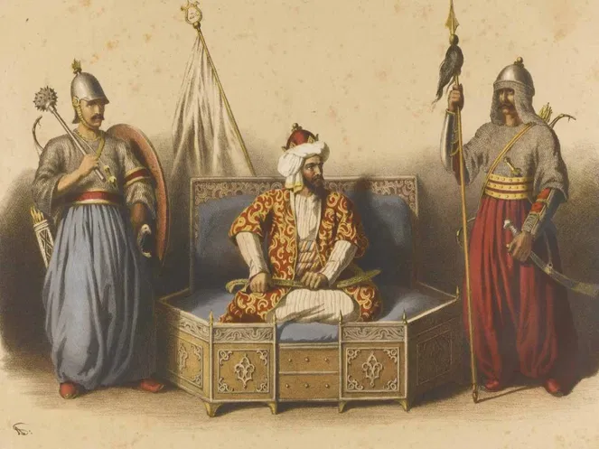
Medieval India: Delhi Sultanate

Slide 2
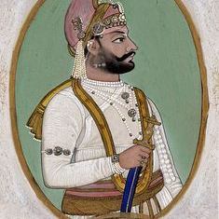
Medieval India: Delhi Sultanate
Delhi became an important city only in the 12th century.
Delhi first became the capital of a kingdom under the Tomara Rajputs, who were defeated in the middle of the twelfth century by the Chauhans

Slide 3
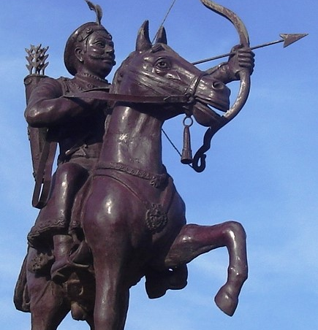
Rajput Dynasty
Tomaras [early twelfth century – 1165]
Ananga Pala [1130 -1145]
Chauhans [1165 -1192]
Prithviraj Chauhan [1175 -1192]

Slide 4
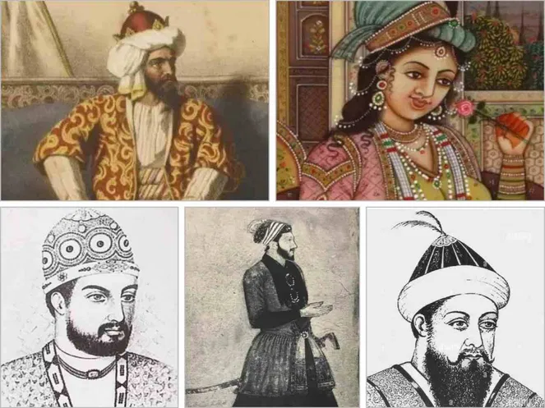
Delhi Sultanate who ruled India before Mughal Empire

Slide 5
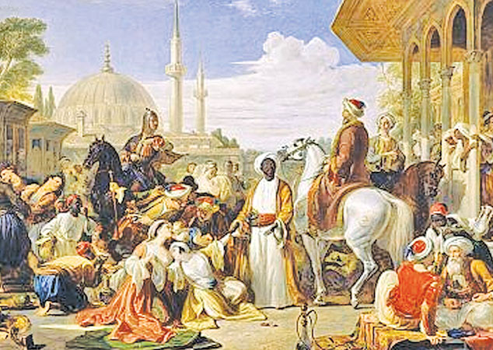
Delhi Sultans
By the 13th century Sultanates transformed Delhi into a capital that controlled vast areas of the subcontinent .
“Histories”, written in Persian, the language of administration under the Delhi Sultans by learned men: secretaries, administrators, poets and courtiers who lived in cities. Objectives of these writings : (a) They often wrote their histories for Sultans in the hope of rich rewards (b) they advised rulers on the need to preserve an “ideal” social order based on birthright and gender distinctions (c) their ideas were not shared by everybody.
In 1236 Sultan Iltutmish’s daughter, Raziyya (Raziyya sultana), became Sultan. Nobles were not happy at her attempts to rule independently. She was removed from the throne in 1240.

Slide 6
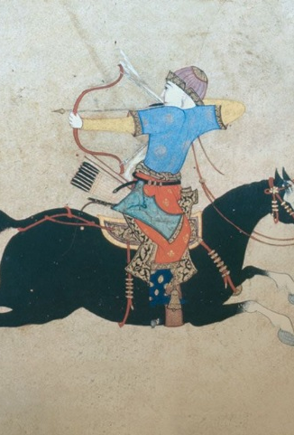
Early Turkish [1206-1290]
The Turks from Central Asia invaded India and ruled from 1175 to 1340 AD who were more interested in wealth rather than politics.
Alauddin Khilji’s (1296-1316) time, though the land revenue was fixed at half of the produce, the land administrators could levy Iqtas- also one kind of land revenue which exploited the farmers more harshly.
Qutbuddin Aybak [1206 -1210]
Shamsuddin Iltutmish [1210 -1236]
Raziyya [1236 -1240]
Ghiyasuddin Balban [1266 -1287]
In the early 13th century, the control of the Delhi Sultans rarely went beyond heavily fortified towns occupied by garrisons.
The Sultans seldom controlled the neighborhood, the lands adjacent to a city or port that supply it with goods and services, of the cities and were therefore dependent upon trade, tribute or plunder for supplies.
Controlling garrison towns in distant Bengal and Sind from Delhi was extremely difficult.
The state was also challenged by Mongol invasions from Afghanistan and by governors who rebelled.
The expansion occurred during the reigns of Ghiyasuddin Balban, Alauddin Khalji and Muhammad Tughluq.

Slide 7
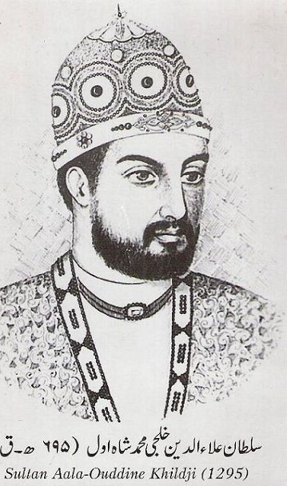
Khilji Dynasty [1290 – 1320] Jalaluddin Khilji [1290 – 1296] Alauddin Khilji [1296 -1316]
So, what the first thing Sultans did were consolidating these neighborhoods of the military base towns. During these campaigns forests were cleared in the Ganga-Yamuna doab and hunter- gatherers and pastoralists expelled from their habitat.
These lands were given to peasants and agriculture was encouraged. New fortresses and towns were established to protect trade routes and to promote regional trade.
Secondly , expansion occurred along the “external frontier” of the Sultanate. Military expeditions into southern India started during the reign of Alauddin Khilji and culminated with Muhammad Tughluq.

Slide 8
Administration & Consolidation
Rather than appointing aristocrats as governors, the early Delhi Sultans, especially Iltutmish, favoured their special slaves purchased for military service, called bandagan .
The Khiljis and Tughluqs continued to use bandagan and also raised people of humble birth, who were often their clients, to high political positions.
Slaves and clients were loyal to their masters and patrons, but not to their heirs.
Authors of Persian tawarikh criticised the Delhi Sultans for appointing the “low and base-born” to high offices.
Military commanders were appointed as governors of territories . This land is called iqta and their holder called iqtadar or muqti . The duty of muqti was to lead military campaigns and maintain law and order in their iqtas.
But still large parts of the subcontinent remained outside the control of the Delhi Sultans.
The Mongols under Genghis Khan invaded Transoxiana in north-east Iran in 1219 and the Delhi Sultanate during the reign of Alauddin Khilji and Muhammad Tughluq .

Slide 9
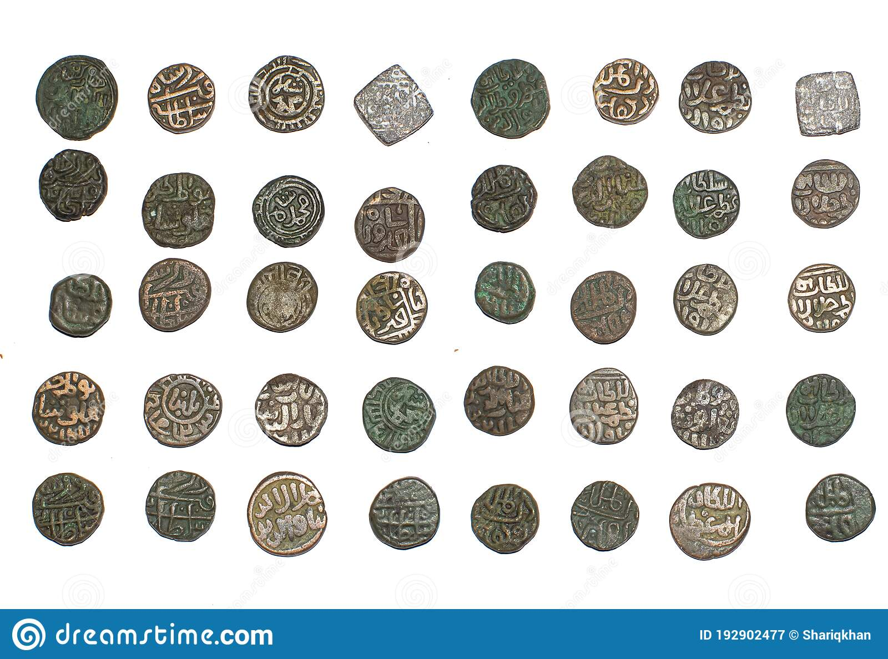
A.Khilji’s defensive policy against Genghis
As a defensive measure, Alauddin Khilji raised a large standing army.
Constructed a new garrison town named Siri for his soldiers.
In order to feed soldiers, produce collected as tax from lands was done and paddy has got fixed tax as 50% of the yield.
Alauddin chose to pay his soldiers salaries in cash rather than iqtas. He made sure merchants sell supplies to these soldiers according to prescribed prices .
So here A.Khilji’s administrative measure were highly praised due to effective intervention in markets to have prices unders control .
He successfully withstood the threat of Mongol invasions .

Slide 10
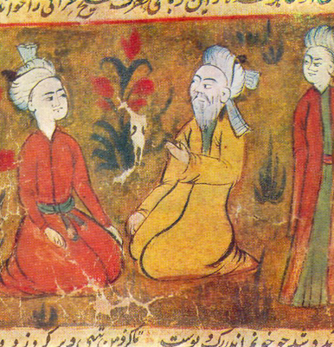
Amir Khusrau
Abu'l Hasan Yamīn ud-Dīn Khusrau (1253–1325 AD), better known as Amīr Khusrau, was an Indian Sufi singer, musician, poet and scholar who lived during the period of the Delhi Sultanate. He is an iconic figure in the cultural history of the Indian subcontinent. He was a mystic and a spiritual disciple of Nizamuddin Auliya of Delhi, India. He wrote poetry primarily in Persian, but also in Hindavi. A vocabulary in verse, the Ḳhāliq Bārī, containing Arabic, Persian and Hindavi terms is often attributed to him. Khusrau is sometimes referred to as the "voice of India" or "Parrot of India" (Tuti-e-Hind) and has been called the "father of Urdu literature”.
Khusrau is regarded as the "father of qawwali" (a devotional form of singing of the Sufis in the Indian subcontinent), and introduced the ghazal style of song into India, both of which still exist widely in India and Pakistan. Khusrau was an expert in many styles of Persian poetry which were developed in medieval Persia, from Khāqānī's qasidas to Nizami's khamsa. He used 11 metrical schemes with 35 distinct divisions. He wrote in many verse forms including ghazal, masnavi, qata, rubai, do-baiti and tarkib-band. His contribution to the development of the ghazal was significant.
Khusrau is credited for the invention of the table and sitar. At the time, there were many versions of the Veena in India. He rechristened the 3 stringed Tritantri Veena as a Setar (Persian for 3 stringed), which eventually became known as the sitar.

Slide 11
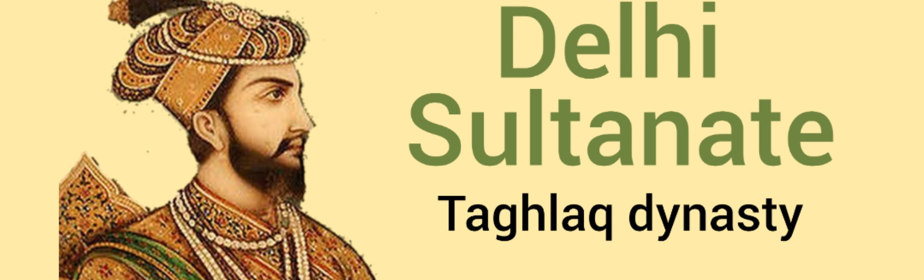
M.Tughluq offensive policy against Genghis
The Mongol army was defeated earlier. M.Tughluq still raised a large standing army.
Rather than constructing a new garrison town he emptied the residents of a Delhi city named Delhi-i Kuhna and the soldiers garrisoned there.
Produce from the same area was collected as tax and additional taxes to feed the large army. This coincided with famine in the area. .
Muhammad Tughluq also paid his soldiers cash salaries. But instead of controlling prices, he used a “token” currency. This cheap currency could be counterfeited easily because it was made of “bronze”.
His campaign into Kashmir was a disaster. He then gave up his plans to invade Transoxiana and disbanded his large army .
His administrative measures created complications. The shifting of people to Daulatabad was resented. The raising of taxes and famine in the Ganga-Yamuna belt led to widespread rebellion. And finally, the “token” currency had to be recalled.

Slide 12
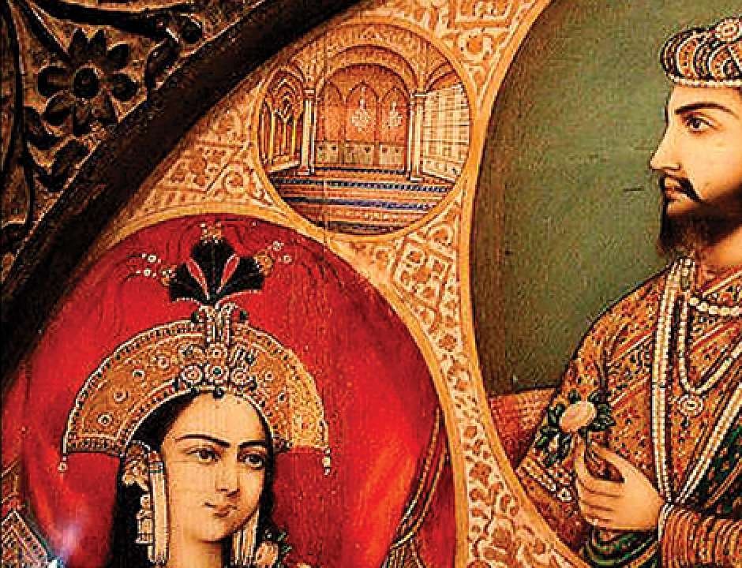
Tughluq Dynasty [1320 – 1414]
Ghiyasuddin Tughluq
[1320-1324]
Muhammad Tughluq
[1324 -1351]
Firuz Shah Tughluq [1351 -1388]

Slide 13
15th & 16th Century Sultanates
Sayyid, Lodi and Suri
Sayyid Dynasty
[1414 – 1451]
Khizr Khan [1414 -1421]
Lodi Dynasty [1451 – 1526]
Bahlul Lodi
[1451 -1489]

Slide 14
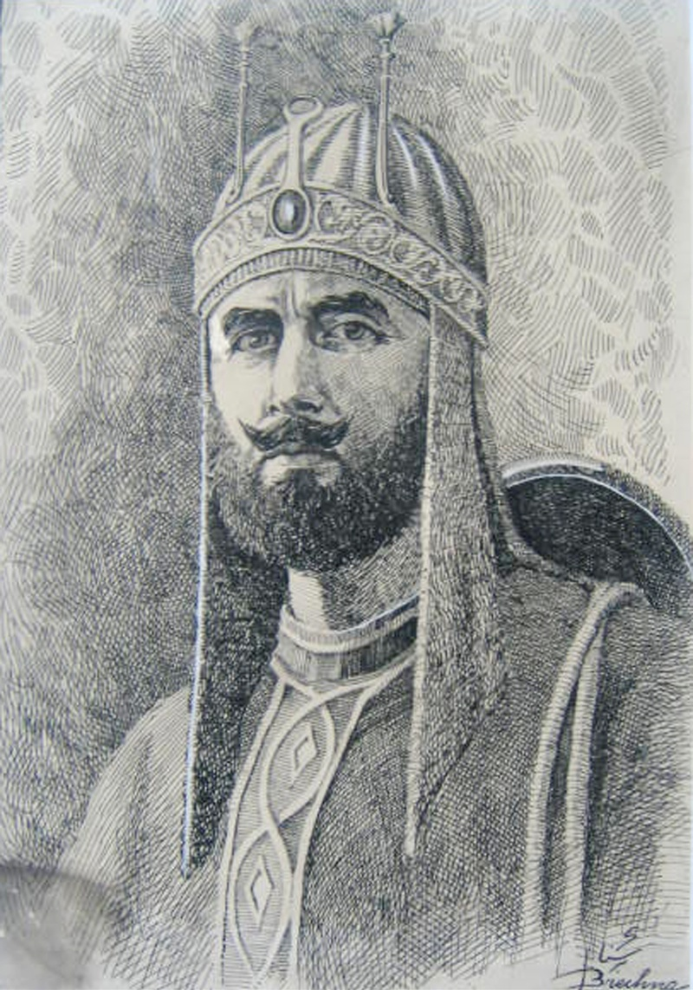
Suri Dynasty [1540-1555]
Sher Shah Suri [1540-1545] captured Delhi.
For the first time during the Islamic conquest the relationship between the people and the ruler was systematized, with little oppression or corruption.
He challenged and defeated the Mughal emperor Humayun (1539 : Battle of Chausa, 1540 : Battle of Kannauj)
Sher Shah introduced an administration that borrowed elements from Alauddin Khalji and made them more efficient.
Sher Shah’s administration became the model followed by the great emperor Akbar (1556-1605) when he consolidated the Mughal Empire.
His tomb is at Sasaram [Bihar]

Slide 15
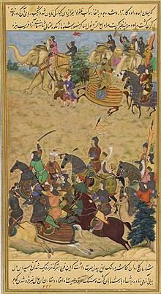
Bengal Sultanate
The Bengal Sultanate was a Sunni Muslim empire based in Bengal for much of the 14th, 15th and 16th centuries. It was the dominant power of the Ganges–Brahmaputra Delta, with a network of mint towns spread across the region. The Bengal Sultanate had a circle of vassal states, including parts of Odisha in the southwest, Arakan in the southeast, and Tripura in the east. Its raids and conquests reached Nepal in the north,Assam in the east, and Jaunpur and Varanasi in the west. The Bengal Sultanate controlled large parts of the north, east and northeast Indian subcontinent during its five dynastic periods, reaching its peak under Hussain Shahi dynasty. It was reputed as a thriving trading nation and one of Asia's strongest states. Its decline began with an interregnum by the Suri Empire, followed by Mughal conquest and disintegration into petty kingdoms.

Slide 16
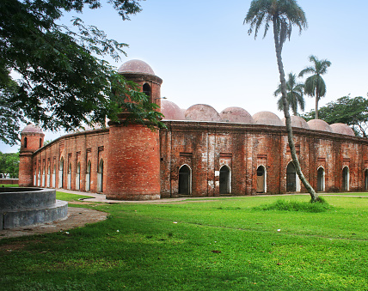
The Bengal Sultanate was a Sunni Muslim monarchy with Bengali, Turco-Persian, Pashtun and Abyssinian elites. The most prominent dynasties were the Ilyas Shahi, House of Ganesha and Hussain Shahi dynasty. The empire was known for its religious pluralism where non-Muslim communities co-existed peacefully. While Persian was used as the primary official, diplomatic and commercial language, it was under the Sultans that Bengali first received court recognition as an official language. The cities of the Bengal Sultanate are termed as Mint Towns where the historical taka was minted. These cities were adorned with stately medieval buildings. In 1500, the royal capital of Gaur was the fifth-most populous city in the world. Other notable cities included the initial royal capital of Pandua, the economic hub of Sonargaon, the Mosque City of Bagerhat, and the seaport and trading hub of Chittagong.

Slide 17
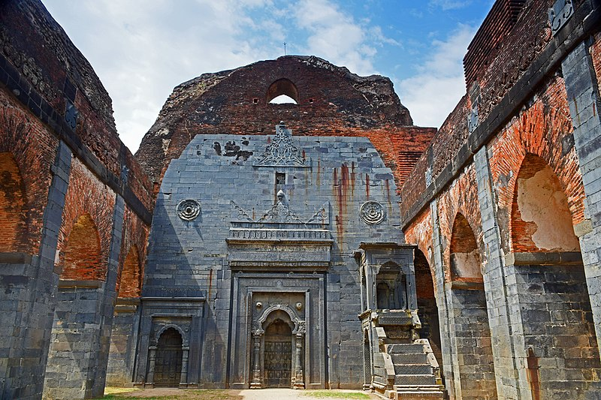
The Bengal Sultanate was connected to states in Asia, Africa, the Indian Ocean, and Europe through maritime links and overland trade routes. The Bengal Sultanate was a major trading center on the coast of the Bay of Bengal. It attracted immigrants and traders from different parts of the world. Bengali ships and merchants traded across the region, including in Malacca, China, and the Maldives.
The Bengal Sultanate was described by contemporary European and Chinese visitors as a prosperous kingdom. Due to the abundance of goods in Bengal, the region was described as the "richest country to trade with". The Bengal Sultanate left a strong art and architectural legacy. Buildings from the period show foreign influences merged into a distinct Bengali style. The Bengal Sultanate was also the largest and most prestigious authority among the independent medieval Muslim-ruled states in the history of Bengal.

Slide 18
End
Medieval India: Delhi Sultanate
Department of Social Science
American International University-Bangladesh

